Slide 1

Secure storage with client-side encryption
Presented by Mohammed Al-Qahtani, Samer Al-Harbi, Ibrahim Al-Amari, Ibrahim Al-Sobhi, Ghalib Al-Harbi
4/24/2026

Slide 2

Introduction
Storing files on a centralized server creates significant security vulnerabilities. When users upload unencrypted data, any compromise of the server exposes that data in plaintext to malicious actors. This project addresses the critical need to protect sensitive information from unauthorized access, ensuring privacy even if the server infrastructure or its administrators are compromised.

Slide 3
Zero-knowledge solution
The application implements a zero-knowledge architecture to protect user data. This security model ensures that the server never receives or stores plaintext files. All file data is fully encrypted on the user's local machine before any transmission occurs. Therefore, the server holds only scrambled, unreadable data, meaning it retains zero knowledge of the actual file contents.

Slide 4
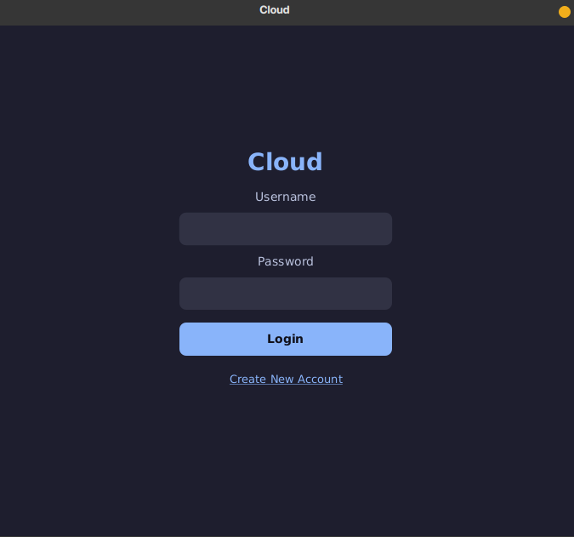

User interface: Sign-IN

Slide 5
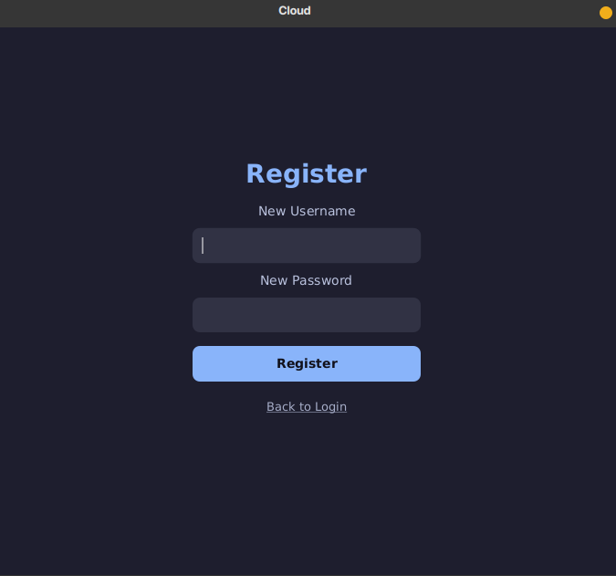
User interface: register

Slide 6
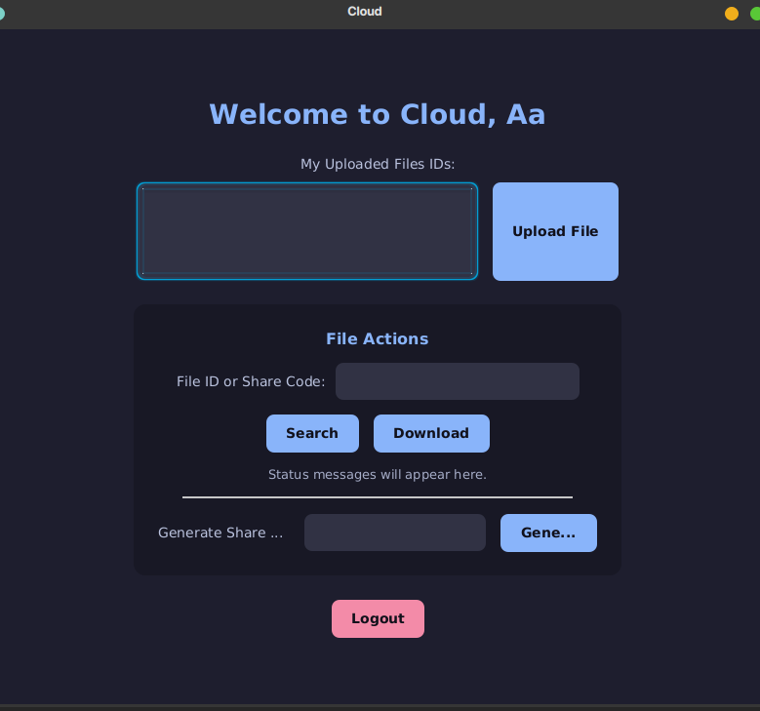
User interface: dashboard

Slide 7
Identity Management & Registration
The system requires users to establish a secure identity during registration by providing a username and a password. This user profile is securely transmitted and stored in the server's user database, acting as the foundation for the user's secure session.

Slide 8
Password Complexity Rules
To ensure the integrity of user accounts, the application strictly enforces password complexity rules during registration. The system verifies that every new password is a minimum of eight characters in length. Furthermore, it dynamically checks the input to ensure it contains at least one uppercase letter and at least one special character, effectively blocking weak credentials.

Slide 9
Key Derivation Function
The application explicitly avoids using raw passwords directly for encryption. Instead, it utilizes a Key Derivation Function (PBKDF2WithHmacSHA256) to transform the user's password into a secure cryptographic Key Encryption Key (KEK). For added security, once the key is derived, the application immediately uses Arrays.fill to overwrite the password characters in the computer's memory, preventing memory-dump attacks.

Slide 10
The Role of the Salt and Iterations
To fortify the derived Key Encryption Key against brute-force and dictionary attacks, the function incorporates two critical security layers. First, it introduces a 16-byte random "salt" to the password, ensuring that identical passwords result in completely different keys. Second, it runs the hashing algorithm through 600,000 iterations, adding computational delay that deters high-speed automated attacks.

Slide 11
Symmetric Encryption (AES-256)
File data is secured using the Advanced Encryption Standard (AES). The system generates a highly secure 256-bit key length for file encryption. As a symmetric algorithm, the exact same mathematical key is required to both encrypt the file before uploading and decrypt the file after downloading. The system utilizes the AES/ECB/PKCS5Padding cipher configuration to handle the data transformation.

Slide 12
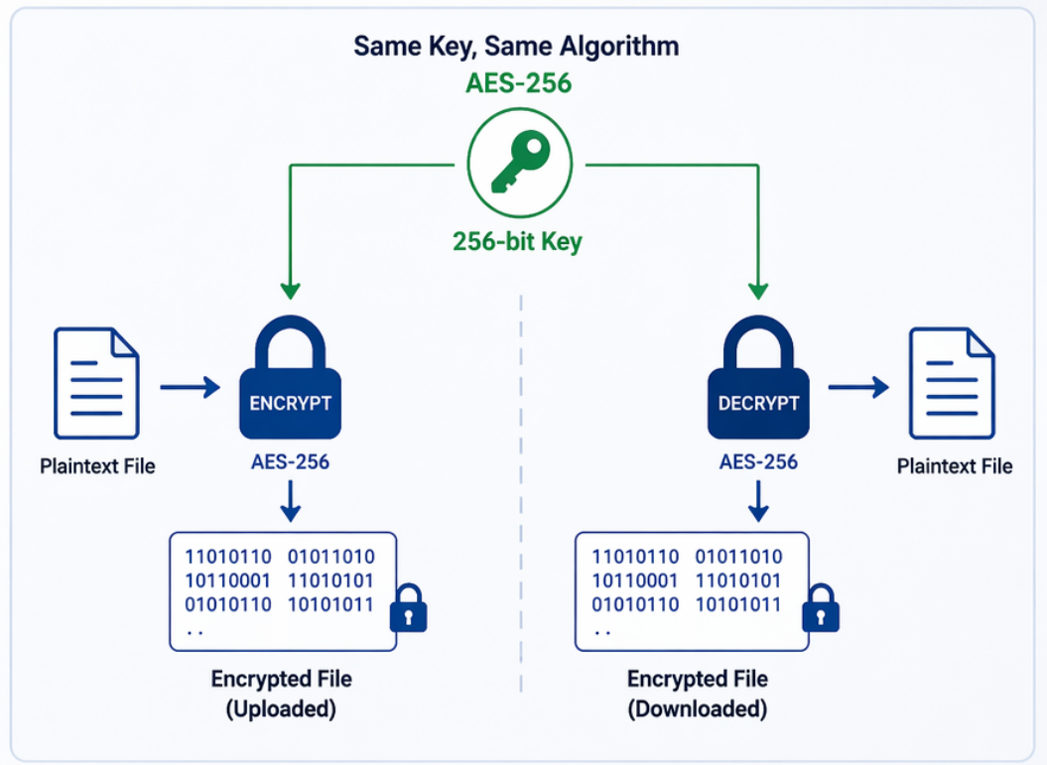
Symmetric Encryption (AES-256)

Slide 13
Envelope Encryption Workflow
The application manages keys securely through an advanced Envelope Encryption process. When uploading a file, the client generates a massive 64-byte Master File Key. This key is split into two halves: the first 32 bytes act as the AES encryption key, and the last 32 bytes act as an HMAC(Keyed-Hash Message Authentication Code) integrity key. The user's derived Key Encryption Key (KEK) is then used to encrypt this entire 64-byte Master File Key, wrapping it in a secure digital envelope.

Slide 14
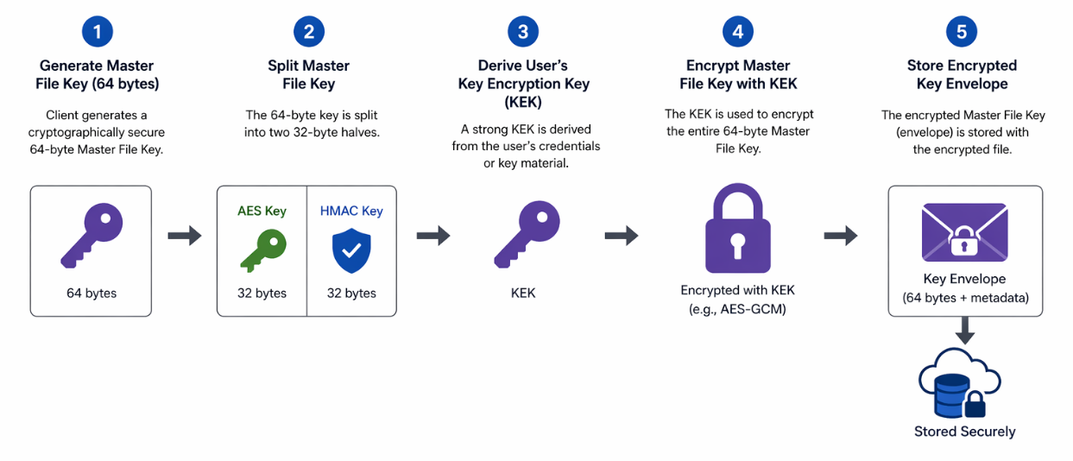
Envelope Encryption Workflow

Slide 15
Memory Management (Chunking)
To ensure application stability when processing large files, the cryptographic engine utilizes a memory management technique called chunking. Instead of loading an entire file into the computer's memory at once, the FileInputStream and Cipher read and encrypt the data in distinct 4096-byte (4 KB) blocks. This prevents memory exhaustion and application crashes regardless of the file size.

Slide 16
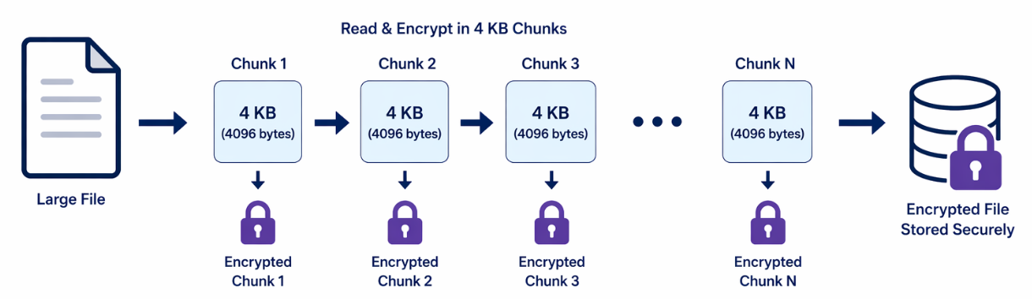
Memory management (chunking)

Slide 17
The encoded metadata string
Instead of writing a custom header directly into the file, the application packages the necessary decryption parameters into a single Metadata String. The system takes the original file name, the 16-byte salt, the encrypted 64-byte Master File Key, and the file's digital signature, encodes them into Base64 format, and separates them with double colons (::). This string is sent to the server alongside the encrypted file blob.

Slide 18
Cryptographic Message Authentication (HMAC)
To guarantee that a file is never maliciously altered, the system utilizes a Keyed-Hash Message Authentication Code (HMAC-SHA256). When a file is uploaded, the cryptographic engine uses the second half of the 64-byte Master File Key as a dedicated secret key to generate a unique digital signature for the file data. This ensures that a malicious actor cannot tamper with the encrypted file and simply recalculate a matching checksum, because generating a valid HMAC signature is mathematically impossible without possessing that specific secret key.

Slide 19
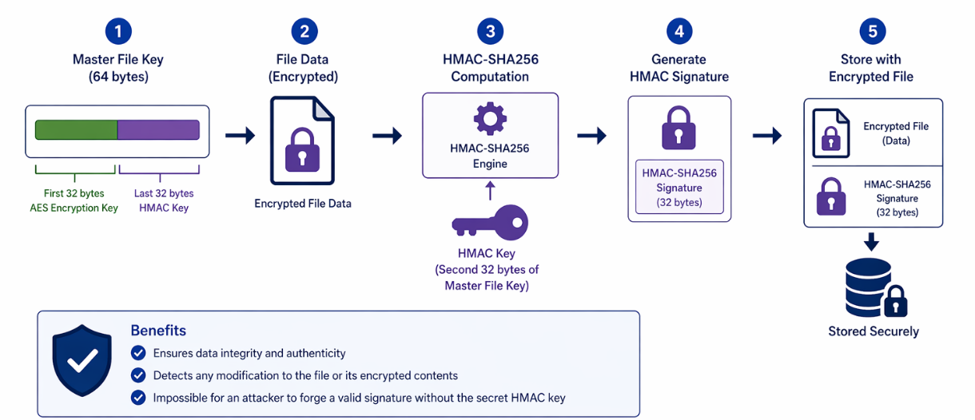
Cryptographic Message Authentication (HMAC)

Slide 20
Simulating an Attack (Tamper Verification)
Upon downloading and decrypting a file, the application calculates a new HMAC signature of the output using the secure HMAC key. It then compares this new signature to the original HMAC stored in the server's metadata. If the file was tampered with during transit, the signatures will fail to match. The system immediately catches this, throws an "Integrity Check Failed" alert to the user, and automatically deletes the compromised file.

Slide 21
The Simulated Backend
The server component is intentionally lightweight and utilizes Java HashMap data structures to simulate a secure backend database. It maintains one registry to map usernames to their hashed passwords. A separate vault map is responsible for storing the StoredVaultFile objects, containing only the raw encrypted file blobs and the Base64-encoded metadata strings, indexed by unique UUIDs(Universally Unique Identifier).

Slide 22
Cryptographic Access Control
In this zero-knowledge architecture, the server is not trusted to manage or enforce file permissions. Therefore, the backend does not maintain Access Control Lists (ACLs) or verify user access during a download request. Instead, security is entirely cryptographic. Anyone who possesses a valid File ID can request and download the encrypted blob from the server, but it is fundamentally impossible to read the contents without the corresponding encrypted keys, which are managed strictly by the user's local client.

Slide 23
The Secure Sharing Mechanism (Share Links)
File sharing is handled entirely through Secure Share Links. When a user wishes to share a file, the client securely retrieves the encrypted Master File Key, decrypts it using the owner's password , and packages the raw 64-byte key into a unique URL-style text string formatted as FileID#Base64Key. The owner can safely provide this text code to a friend. To access the file, the friend inputs the code into their dashboard ; the application splits the code , downloads the file by its ID , and decrypts the contents locally using the embedded key.

